Slide 1

Regulatory and market innovation
OFFSHORE ENERGY ISLANDS
7 MAY 2024, BORNHOLM BALTIC ENERGY ISLAND SUMMIT
Lena kitzing,
head of Division Wind ENERGY SYSTEMS, Technical UNIVERSITY OF DENMARK

Slide 2
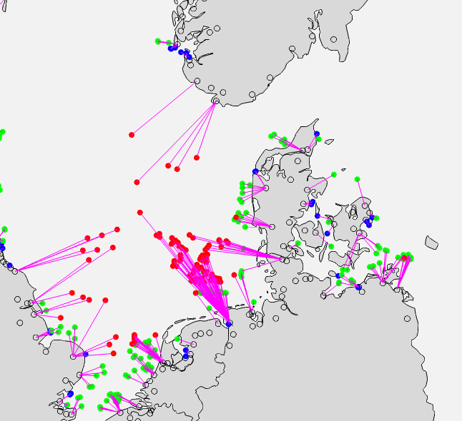
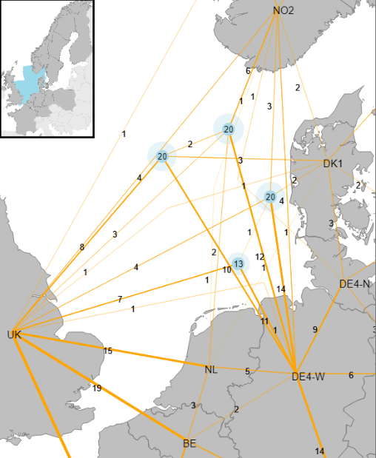
Integration of offshore wind – from current practice to future
Source: Juan Gea-Bermudez, PhD thesis, Modelling and optimization of the North Sea region's energy system in the long term, link
Strong reinforcement of the grid is needed to integrate large shares of VRE in a cost-effective way
An extensive offshore grid is crucial in all decarbonisation scenarios
Notes:
PTDF: Power transfer Distribution function

Slide 3
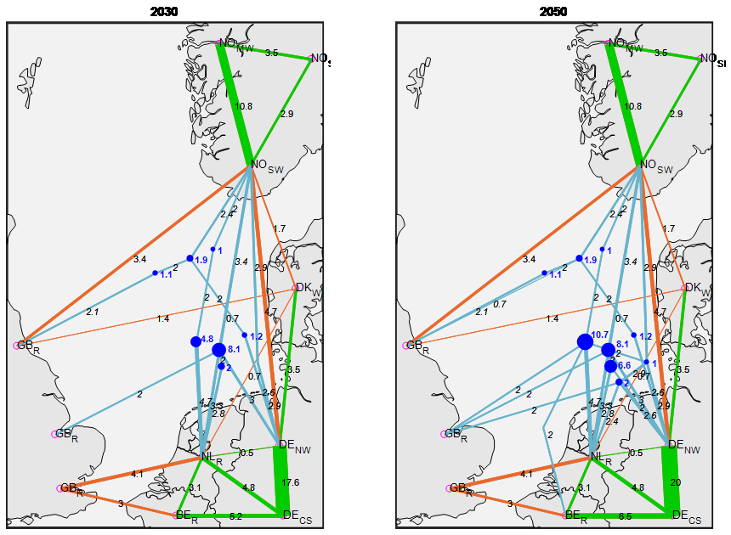
Anticipatory investments: There is value in ”intertemporal offshore grid planning”, i.e. building now looking ahead
2030
2050
Considering future expected hub development in today’s interconnector investments is important to reduce overall costs of the system
Notes:
Lets now focus on offshore grids.
The picture shows the offshore grid resulting from the optimization in 2030 and 2050.
Different purpose of the line in 2030 and 2050! Only as C2C dispatch in 2030, and double use in 2050 (blue dot is the wind farm).
With this planning, emissions and costs are reduced.
Without performing intertemporal optimization, this result was not possible

Slide 4




Regulation and Market Challenges in the new offshore paradigm
Anticipatory Investments
Interconnectors
GRID
Market Coupling
Curtailment
Bidding zones
Compensation
MARKET
Hub-to-Shore
TAG
HUBS
Hub-to-Hub
Park-to-Hub
CfD
Park-to-Park effects
Revenue guarantee
PARKS
Profit requirement
Cost uncertainty
Supply Chains
Notes:
Some say : comensation against volume risk
Price risks addressed through CfD / but can also be tackled through TAGs –
Future price risks through revenue guarantees , but would not be an issue if CfDs…
There all have benefits and disadvantages - /pros and cons – I cannot go through all of these – but food for discussion for the session

Slide 5
Principles for regulation and policy design
>> A moving target that depends on interrelated factors where outcomes and decisions all influence one another
Short-term efficiency / socio-economic welfare maximisation
Foresight & anticipatory investments
Long-term sustainable investment environment
Speed of implementation
Feasibility of (international) agreement
Tradeoffs and risk considerations:
Volume risks & price risks
Today’s risks & future risks
All need to be balanced

Slide 6
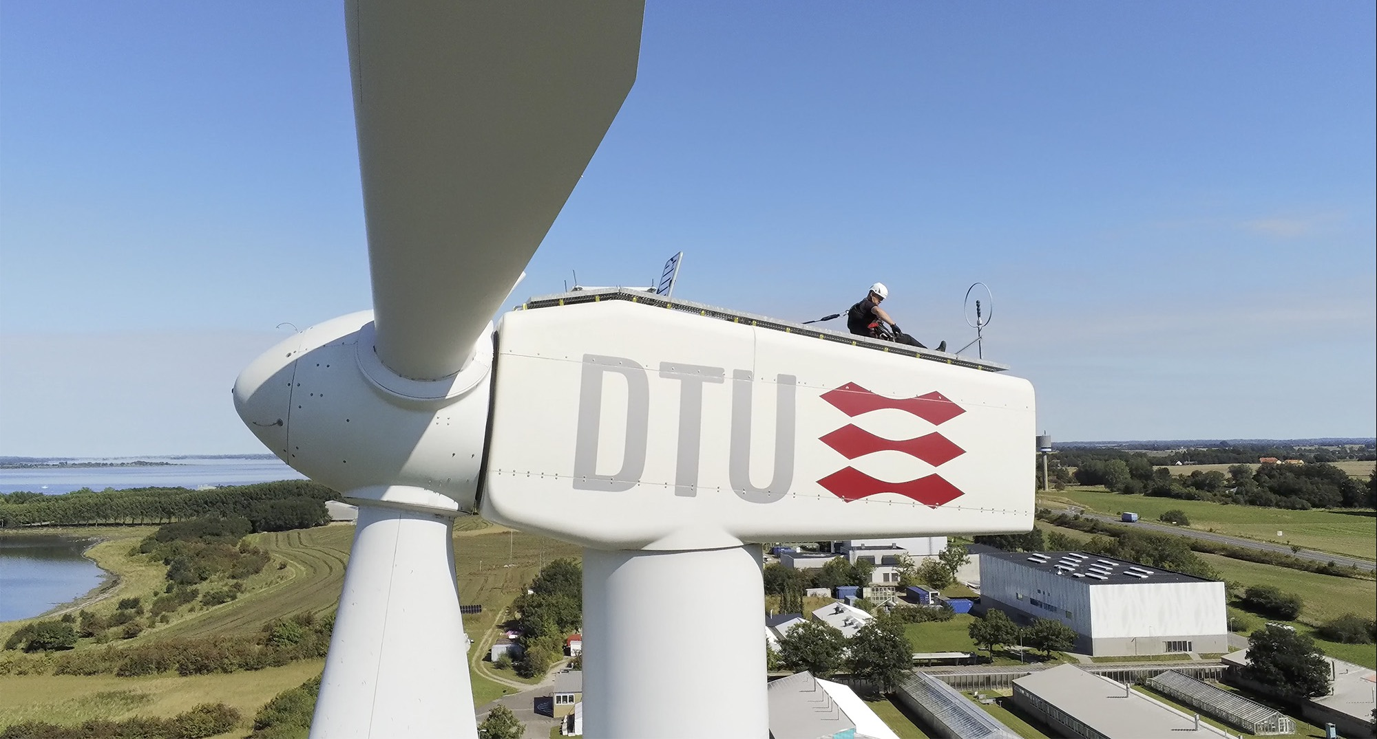



Questions & Answers
THANK YOU
CONTACT ME AT:
LENA KITZING, lkit@dtu.dk
LinkedIn
@LenaKitzing

